Slide 1
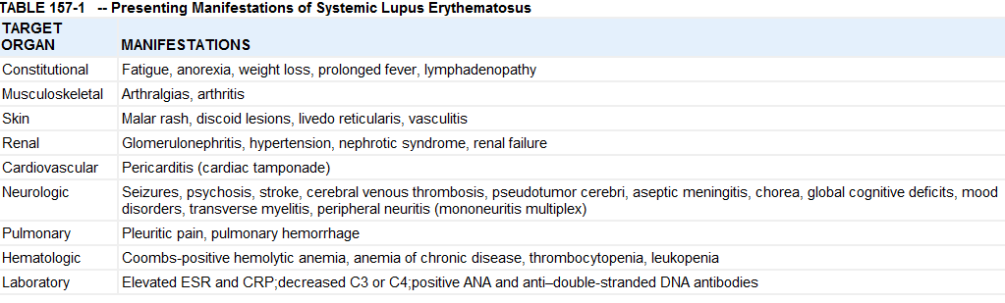
SLE
The hallmark of lupus is autoantibody production against many self antigens
Female predominance varies from 4 : 1 before puberty to 8 : 1 afterwards

Slide 2
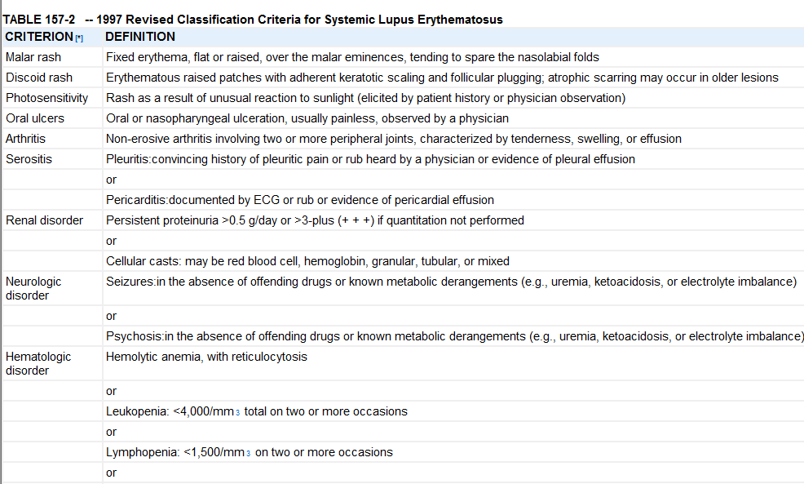
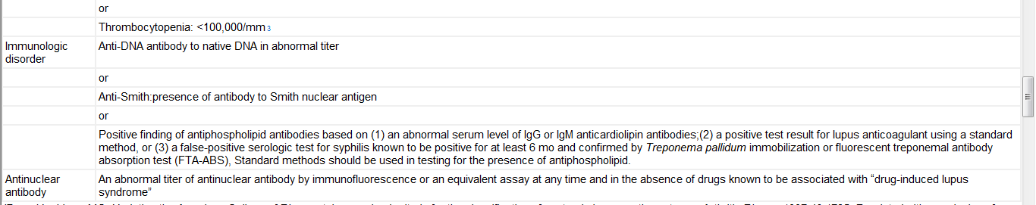

Slide 3
Drug-induced lupus is a lupus-like disease that is precipitated by exposure to certain drugs, notably many anticonvulsants, sulfonamides, and antiarrhythmic agents
Ixn - ANA, Anti dsDNA, Anti Smith
serum complement
Mgt
Non steroidal drugs: Arthritis and arthralgia, if not nephritis.
Anticoagulants: in patients with thrombosis and anti-phospholipid antibodies.
Corticosteroids: mainstay of therapy.
Cyclophosphamide.
Five year survival is now >90%.
Death: is usually because of nephritis, CNS complications, and Infections, pulmonary hemorrage or myocardial infarction

Slide 4
JRA
Three principal types of onset:
  Oligoarthritis or pauciarticular disease: Predominantly affects the joints of the lower extremities, only a single joint is involved at onset.
  Polyarthritis : Inflammation of only ≥5 joints is required as a criterion for classification of this type of onset
Systemic-onset disease : prominent visceral involvement that includes hepatosplenomegaly, lymphadenopathy, and serositis. It is characterized by a quotidian(every day) fever with temperatures to ≥39°C, sometimes followed by mildly hypothermic temperatures for ≥2 wk. Each febrile episode is frequently accompanied by a characteristic faint, erythematous, macular rash; These evanescent salmon-colored lesions may be linear or circular, from 2–5 mm in size, and are often distributed in groups with a linear distribution most commonly over the trunk and proximal extremities
  The Koebner phenomenon, which is cutaneous hypersensitivity to superficial trauma resulting in a localized recurrence of the rash, is suggestive, but not diagnostic, of systemic-onset disease. Heat, such as a warm bath, also evokes a reappearance of the rash

Slide 5
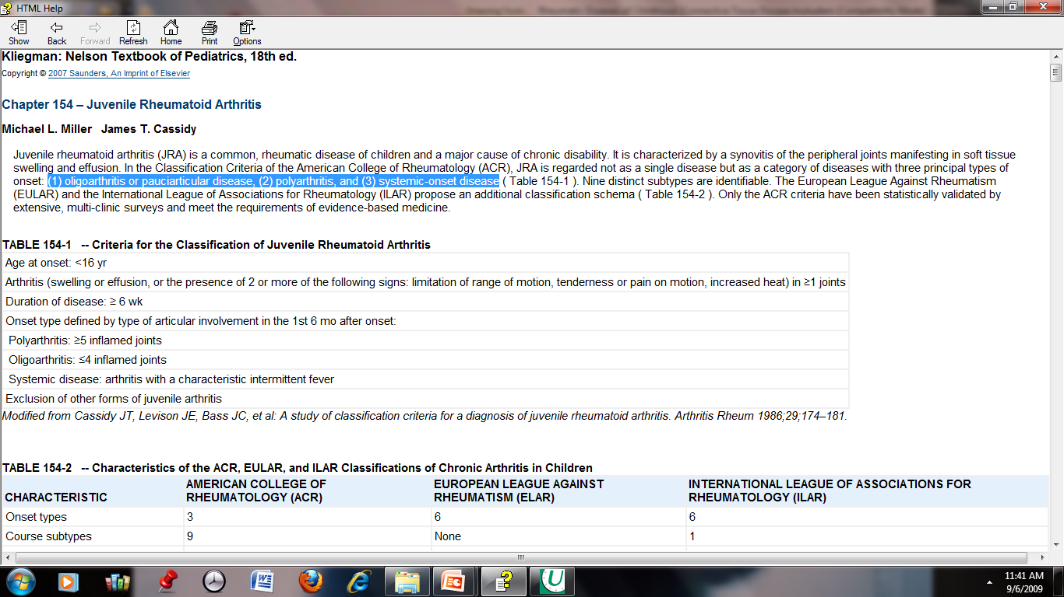
C/F – Initial symptoms may be subtle or acute, and often include morning stiffness and gelling, easy fatigability, particularly after school in the early afternoon, joint pain later in the day, and objective joint swelling. The involved joints are often warm, resist full range of motion, are painful on motion, but are not usually erythematous

Slide 6
Ixn – ANA, CBC(anemia and thrombocytopenia), RF, ESR, CRP,
X-ray : soft tissue swelling, regional osteoporosis, and periosteal new-bone
apposition about affected joints
Rx
  Goal: preserve joint function and approximate normal life style with few side effects possible.
  NONSTEROIDALS: including aspirin, are the first line drugs.
  METHOTREXATE: safest second line drug ( replaced gold salts).
  ANTIMALARIALS: occasionally used.
  CORTICOSTEROIDS: few indications.
  PHYSIOTHERAPY AND OPHTHALMOLOGIC FOLLOW UP: extremely important.

